Slide 1


FOUNDATION OF DATA SCIENCE: PROJECT 1
DIAGNOSING PARKINSON’S DISEASE USING VOICE SAMPLE DATA ANALYSIS
Group Name: |  | 63
Khai Quang Thang |  | [s367530]
Natnicha (Sandria) Thaisin |  | [s365304]
Van Phuc Vinh Ho |  | [s366270]
Yi Liang |  | [s368689]

Slide 2

II. DESCRIPTIVE STATISTICS
I. Project and Data Brief
Input
Output
26 sound variables measurements were extracted from 20 individuals with Parkinson's Disease (PD) and 20 healthy individuals (non-PD).
A binary classification indicating the variable (1: PD ; 0: non-PD).
Project Objective
To determine a set of salient variables (features) that could be used to distinguish people with PD from those that are healthy.

Slide 3
II. DESCRIPTIVE STATISTICS
II. Analytical approach
DATA PROCESSING
Creating new labeled columns.
Descriptive statistics: Missing value, Redundant value, Outliers: Detect outliers using box plots.
DATA STATISTICS
Descriptive data
Visualization histogram to test normal distribution and bar chart
Data Transformation: Apply transformations (logarithmic)
T-TEST HYPOTHESIS
Hypothesis
Result
CORRELATION
Visualization correlation between 16 significant features.
Visualization boxplot between 16 significant features.

Slide 4
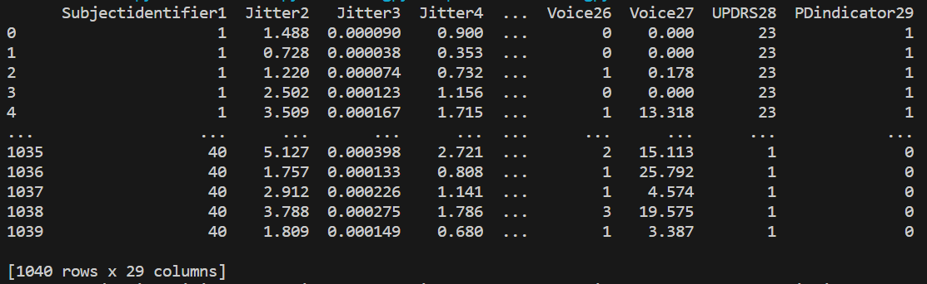
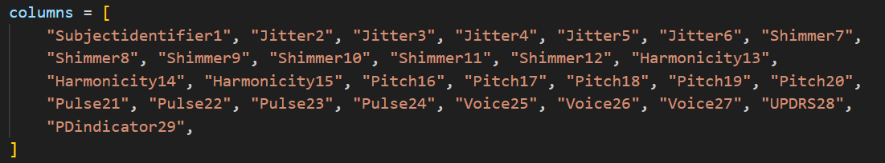
I. DATA PROCESSING
Creating a new table with labelled columns
After opening the file “po1_data.txt”, our group processed the data to the table with labeled columns and classifying the data set into 29 columns and 1024 rows.
List of 29 colums

Slide 5
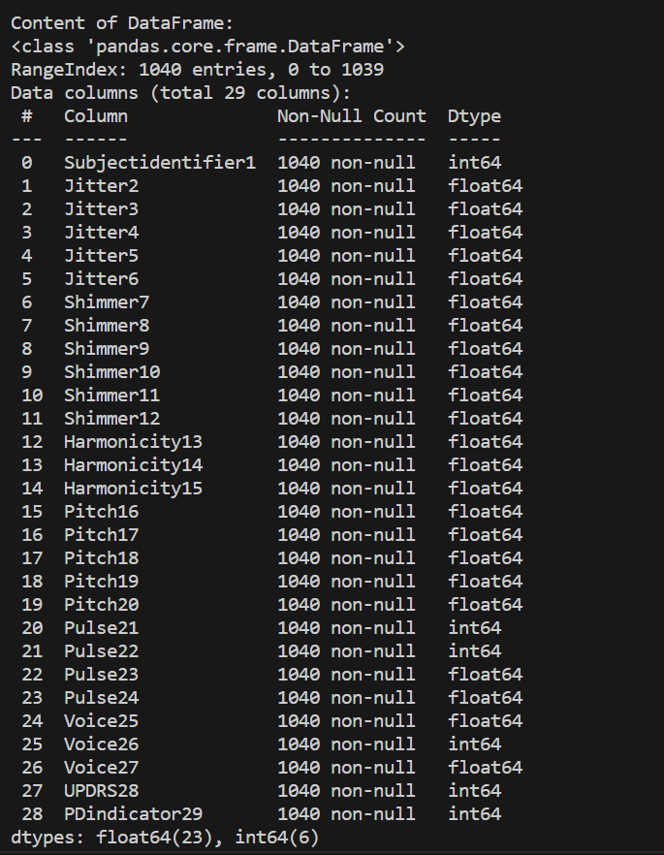
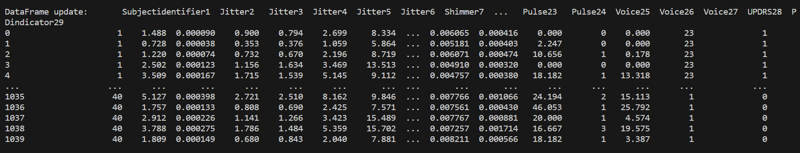
II. DATA WRANGLING
Inspect DataFrame content
Output: 1040: non-null for 29 variables
Inspect DataFrame content
Output: 05 rows in the dataset.
Check duplicate
Output: the dataset is efficient input information.
List of 29 colums

Slide 6
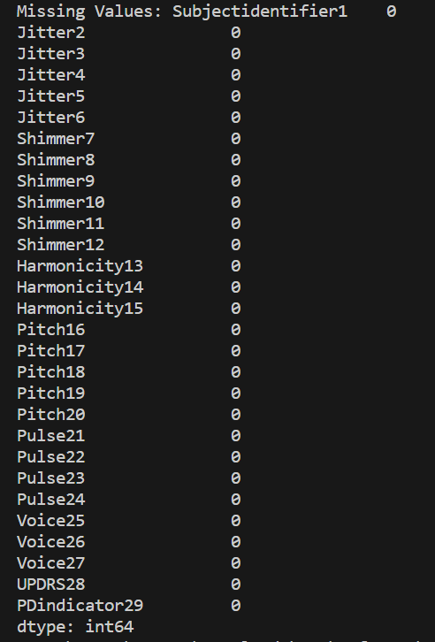
II. DATA WRANGLING
Check missing value
Output: 0 missing value for 29 variables
Conclusion
After processing data, we are confident to compute descriptive statistics.

Slide 7
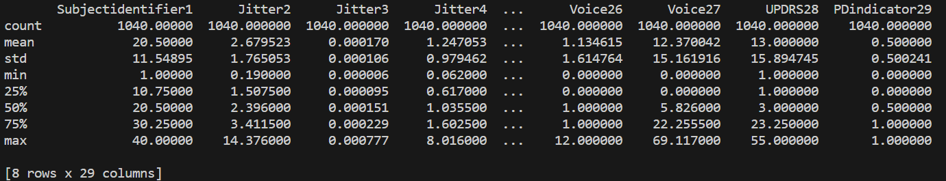
III. DESCRIPTIVE STATISTICS
Describe the dataset
When applying the code “df.describe()”, collecting the basic information from the data, including measure indexes: + Count: total rows + mean + Standard Deviation + Min + 25th percentile + 50th percentile + 75th percentile + Max
To check all 29 variables in the data set, converting the output onto the data.csv file
##Coding df.describe().T.to_csv('descriptive statistics.csv')

Slide 8
II. DESCRIPTIVE STATISTICS
III. DESCRIPTIVE STATISTICS
 | count | mean | std | min | 25% | 50% | 75% | max
Subjectidentifier1 | 1040 | 20.5 | 11.5489501 | 1 | 10.75 | 20.5 | 30.25 | 40
Jitter2 | 1040 | 2.679522692 | 1.765052535 | 0.19 | 1.5075 | 2.396 | 3.4115 | 14.376
Jitter3 | 1040 | 0.000170398 | 0.000106454 | 6.50E-06 | 9.49E-05 | 0.000151 | 0.000229 | 0.000777
Jitter4 | 1040 | 1.247052846 | 0.979462029 | 0.062 | 0.617 | 1.0355 | 1.6025 | 8.016
Jitter5 | 1040 | 1.348327115 | 1.138741963 | 0.081 | 0.66575 | 1.1265 | 1.69475 | 13.542
Jitter6 | 1040 | 3.741161385 | 2.938442884 | 0.185 | 1.85175 | 3.107 | 4.8085 | 24.048
Shimmer7 | 1040 | 12.91839062 | 5.452203989 | 1.185 | 9.3535 | 12.3485 | 15.49325 | 41.137
Shimmer8 | 1040 | 1.194895231 | 0.420070796 | 0.103 | 0.941 | 1.1815 | 1.411 | 2.721
Shimmer9 | 1040 | 5.699600269 | 3.01518259 | 0.496 | 3.703 | 5.1345 | 6.942 | 25.82
Shimmer10 | 1040 | 7.98355191 | 4.84089195 | 0.708 | 5.16025 | 7.0505 | 9.55893 | 72.86
Shimmer11 | 1040 | 12.21534547 | 6.016260924 | 0.517 | 8.0795 | 11.41866 | 15.30613 | 44.764
Shimmer12 | 1040 | 17.09883896 | 9.045537155 | 1.488 | 11.1095 | 15.403 | 20.826 | 77.459
Harmonicity13 | 1040 | 0.84601339 | 0.085708996 | 0.539566 | 0.803026 | 0.8569 | 0.904218 | 0.997904
Harmonicity14 | 1040 | 0.231378569 | 0.15128302 | 0.002106 | 0.12689 | 0.206196 | 0.297583 | 0.869277
Harmonicity15 | 1040 | 9.999541692 | 4.29130402 | 0.695 | 7.51025 | 9.638 | 12.08725 | 28.418
Pitch16 | 1040 | 163.3682856 | 56.02167794 | 81.46 | 124.0758 | 150.636 | 192.4768 | 468.618
Pitch17 | 1040 | 168.7276206 | 55.9699128 | 82.363 | 126.5948 | 154.7325 | 201.2205 | 470.456
Pitch18 | 1040 | 27.54762931 | 36.67262401 | 0.533 | 7.2955 | 12.7735 | 27.553 | 293.877
Pitch19 | 1040 | 134.5381008 | 47.05805827 | 67.957 | 100.8523 | 127.277 | 159.6648 | 452.083
Pitch20 | 1040 | 234.8759899 | 121.5412428 | 85.541 | 143.6508 | 195.971 | 263.7983 | 597.974
Pulse21 | 1040 | 109.7442308 | 150.0277035 | 0 | 42.75 | 65 | 113 | 1490
Pulse22 | 1040 | 105.9692308 | 149.417074 | 0 | 40.75 | 62 | 109 | 1489
Pulse23 | 1040 | 0.006546608 | 0.001875313 | 0.002039 | 0.005039 | 0.006484 | 0.007923 | 0.01207
Pulse24 | 1040 | 0.000842529 | 0.000723069 | 5.53E-05 | 0.000404 | 0.000644 | 0.00098 | 0.006371
Voice25 | 1040 | 27.68285577 | 20.9752942 | 0 | 8.14925 | 26.501 | 43.06425 | 88.158
Voice26 | 1040 | 1.134615385 | 1.614764007 | 0 | 0 | 1 | 1 | 12
Voice27 | 1040 | 12.37004231 | 15.16191604 | 0 | 0 | 5.826 | 22.2555 | 69.117
UPDRS28 | 1040 | 13 | 15.89474523 | 1 | 1 | 3 | 23.25 | 55
PDindicator29 | 1040 | 0.5 | 0.500240558 | 0 | 0 | 0.5 | 1 | 1
This is the output of csv file

Slide 9
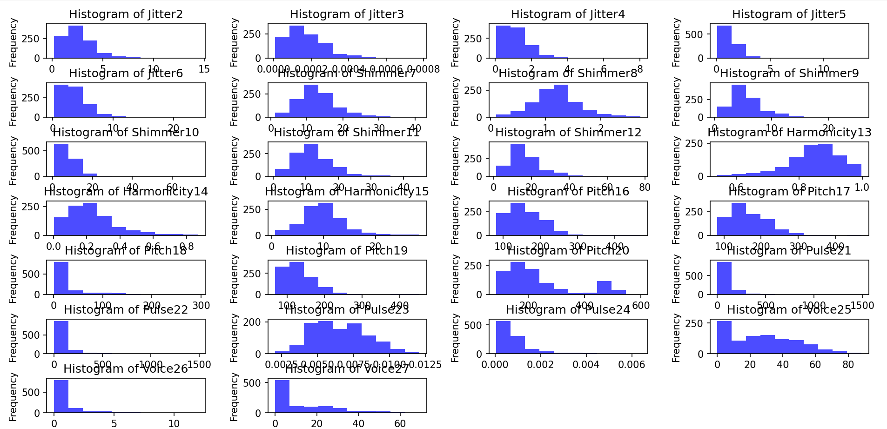
IV. VISUALIZATION HISTOGRAM FOR 26 VARIABLES
Conclusion
As can be seen, most of the histograms are not normal distributions.
ASSUMPTION
Based on the histogram, we assume that all 26 variables are approximately normally distributed to compute T-Test hypothesis.

Slide 10
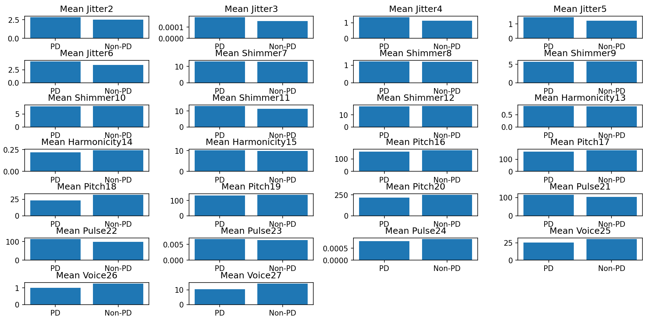
V. PERFORM A STATISTICAL ANALYSIS BETWEEN TWO GROUP
(PD and Non-PD)
Conclusion
As can be seen in the diagram, the mean between the two groups PD and Non-PD has a difference.
Convince
To prove the valuable meaning of the significant difference between the two groups PD and non-PD, we begin compute T-test

Slide 11
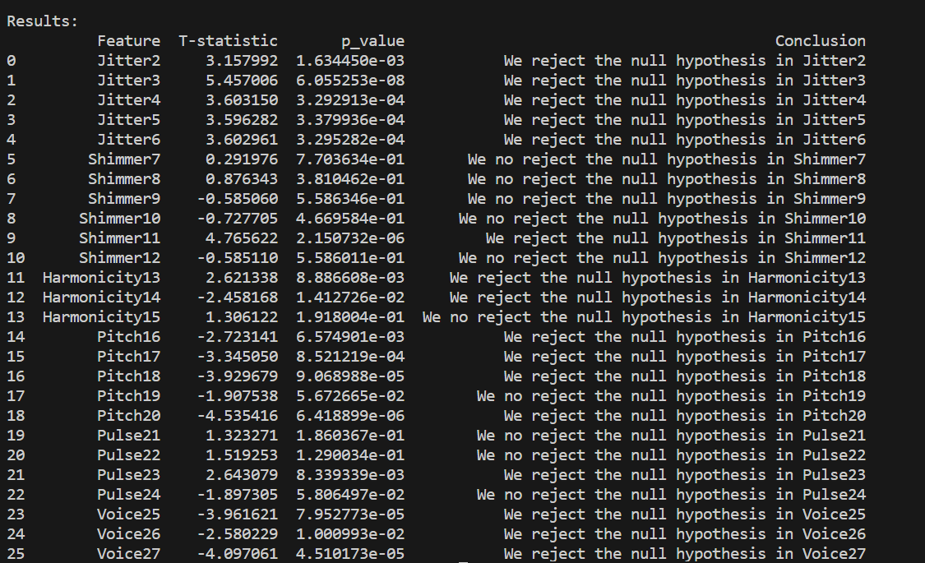
VI. T-TEST HYPOTHESES
P_value
P_value < 0.05 => Reject Ho P_value>0.05 => Don’t reject Ho
Hypotheses
Ho: There is no difference between the two groups (PD and Non-PD) in each variable
Ha: There is a difference between the two groups (PD and Non-PD) in each variable

Slide 12
VI. T-TEST HYPOTHESES
Conclusion
We do not reject the null hypothesis (H0) for 10 variables: Shimmer7, Shimmer8, Shimmer9, Shimmer10, Shimmer12, Harmonicity15, Pitch19, Pulse21, Pulse22, Pulse24. It means that there is no significant difference between the two groups PD and Non_PD. There is enough evidence to reject the null hypothesis (H0) for 16 variables: Jitter2, Jitter3, Jitter4, Jitter5, Jitter6, Shimmer11, Harmonicity13, Harmonicity14, Pitch16, Pitch17, Pitch18, Pitch20, Pulse23, Voice25, Voice26, Voice27. It demonstrates that there is a difference between the two groups (PD and Non-PD). Therefore, we can use these 16 variables to identify who is Parkinson or not.
Results
16 significant features:

Slide 13
VI. T-TEST HYPOTHESES
LIMITATION
We have to accept this result with the limitation. This is because the sample data is not normally distributed. Therefore, the power of the p-value may be limited. If we need to prove a firm conclusion with a confident interval, we must increase the sample data volume.
15 Non-normal distribution
+ Jitter2, Jitter3, Jitter4, Jitter5, Jitter6. + Harmonicity13, Harmonicity14. + Pitch16, Pitch17, Pitch18, Pitch20. + Pulse23. + Voice25, Voice26, Voice27
1 Approximately Normal distribution
+ Shimer11

Slide 14
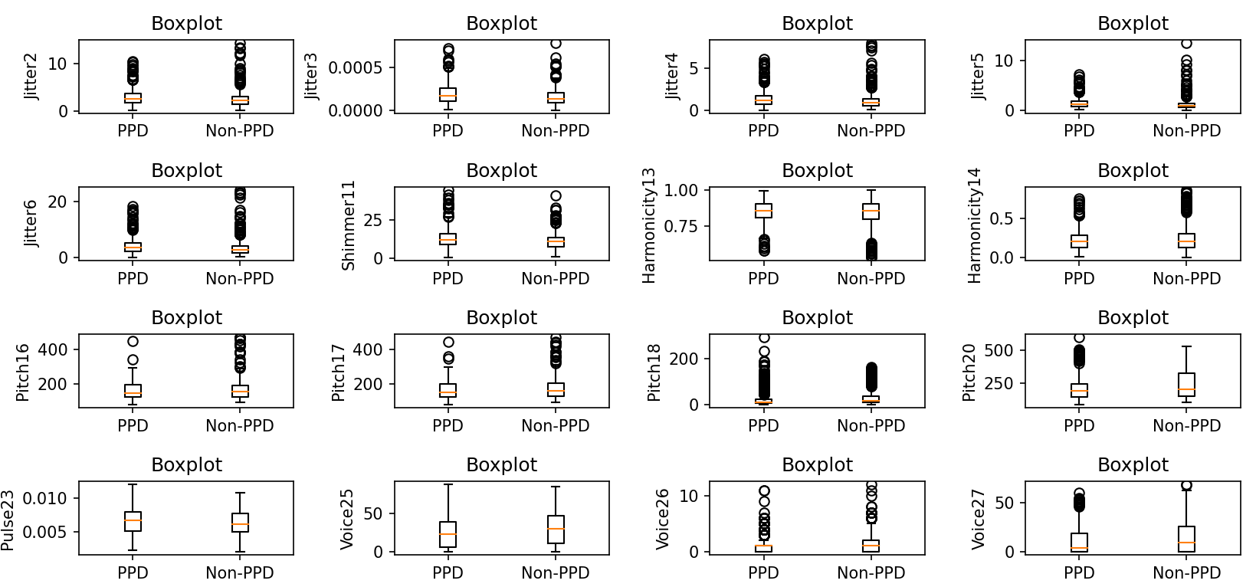
VIII. VISUALIZATION OF THE DISTRIBUTION OF DATA IN EACH VARIABLE BETWEEN THE TWO GROUP PD AND NON_PD
Comment:
The boxplot diagrams revealed the presence of the average, minimum, maximum, and median values and some outliers, illustrating the distinctions between data of PD and non-PD groups and providing us with a comprehensive understanding of the data's distribution.

Slide 15
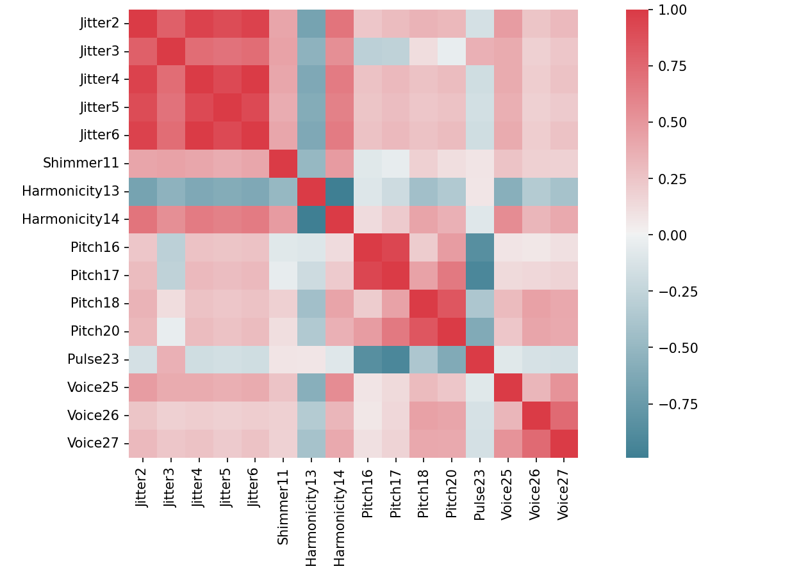
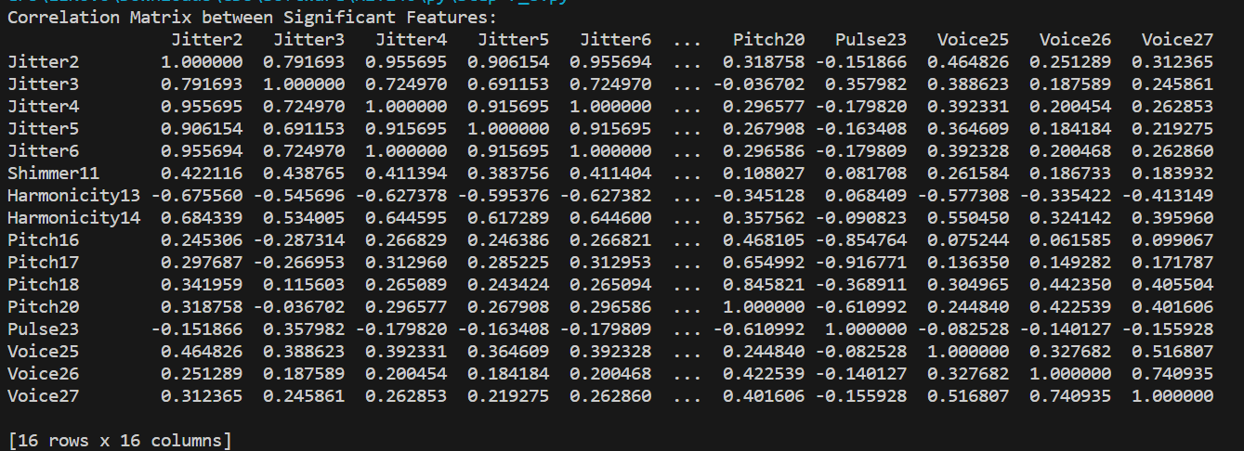
VII. CORRELATION BETWEEN SIGNIFICANT FEATURES
Heatmap showing the correlation between 16 variables
Correlation Matrix between significant features
Comment:​
The heatmap illustrates the correlations between the 16 variables, with Jitter 2 - 6 exhibiting a strong positive correlation with each other, while Harmonicity 13 and Pulse 23 display mostly negative correlations with the other variables.​

Slide 16
THANK YOU!!!

